Slide 1
Human computer interaction
Covid-19 information application
Talha Sarfaraz 61933
Mohsin Ali 62008

Slide 2
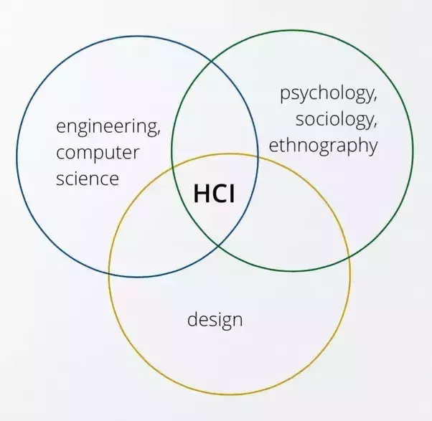
The Goals of HCI
The goals of HCI are to produce usable and safe systems, as well as functional systems. In order o produce computer systems with good usability, developers must attempt to:
understand the factors that determine how people use technology
develop tools and techniques to enable building suitable systems
achieve efficient, effective, and safe interaction
put people first

Slide 3
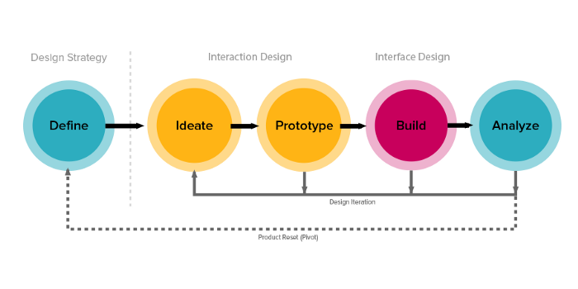
UX process

Slide 4
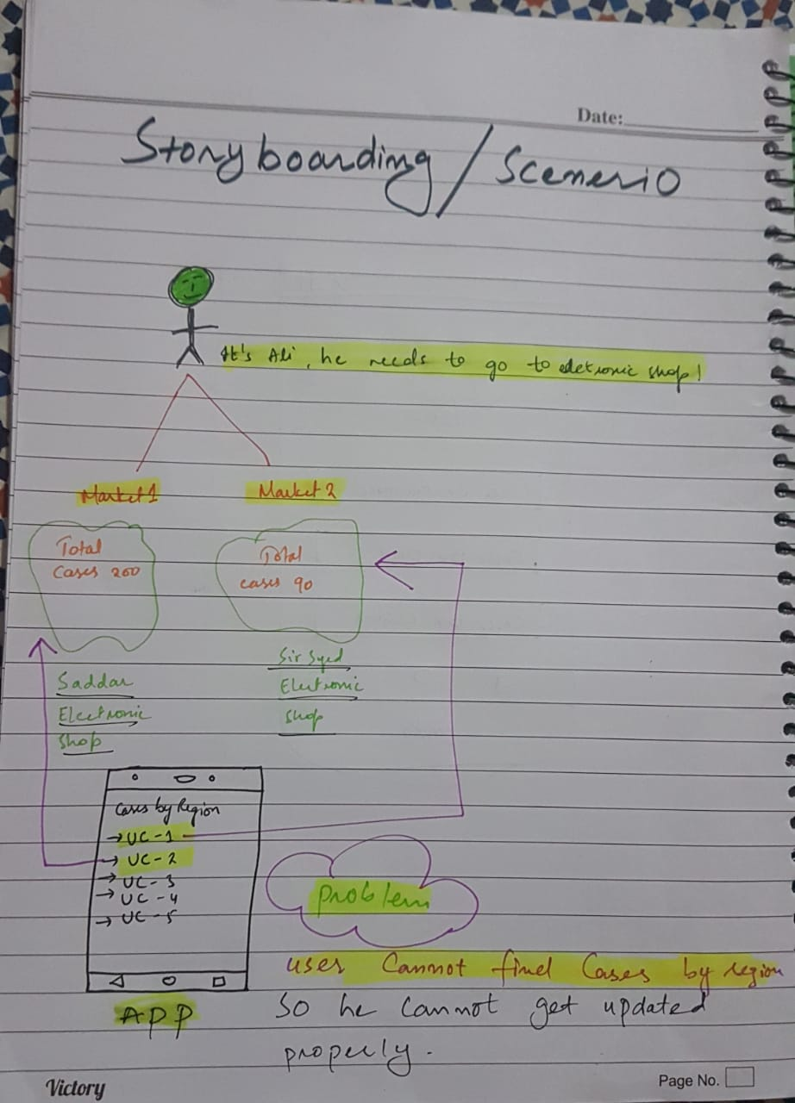
Design Process story board
Problem in this design is that user cannot updated properly

Slide 5
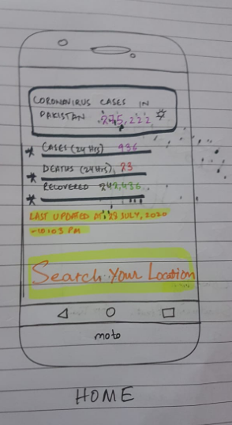
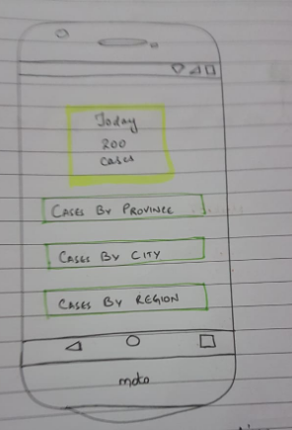
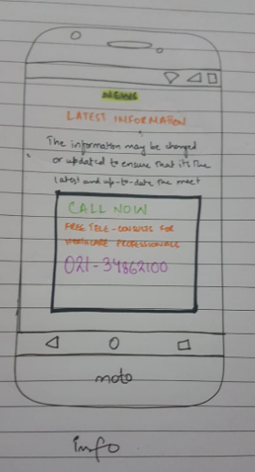
Design process prototypes

Slide 6
Design process prototypes
This is our first mockup which we design from the help different design application
There are some things which need to be change in design to help user to easily interact with application.
We design another mockup with changes which we point out in pervious mockup.

Slide 7
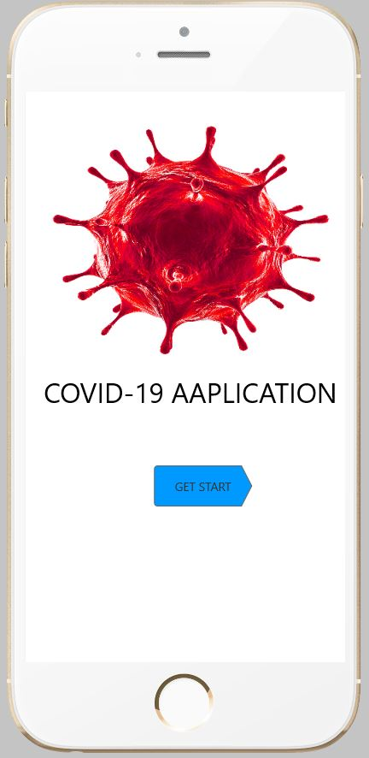
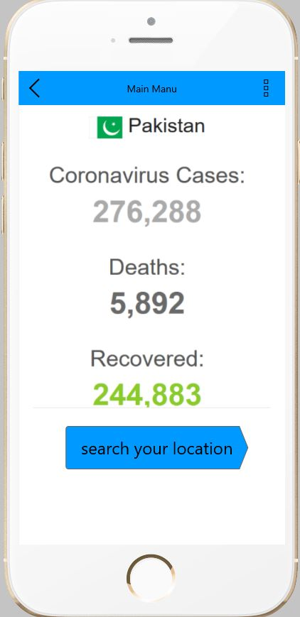
Design process prototypes process 2

Slide 8
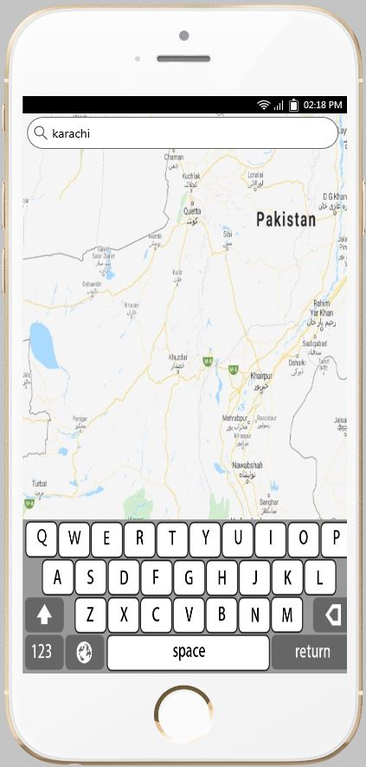
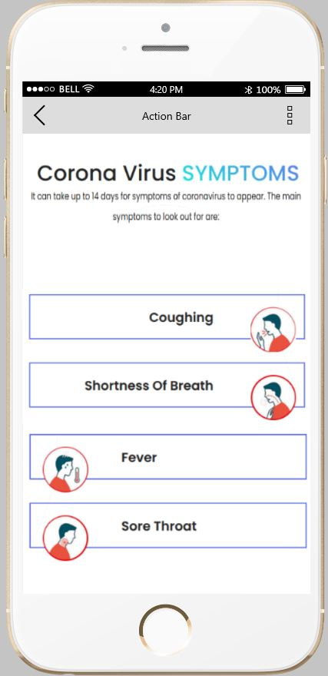
Design process prototypes process 2

Slide 9
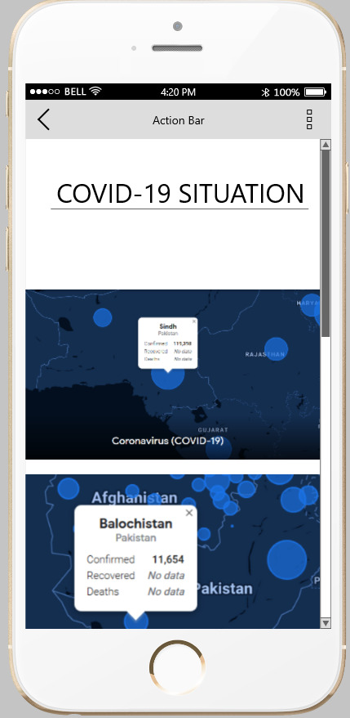
Design process prototypes process 2

Slide 10
Design process prototypes process 2
This is our final UI for covid-19 app
Thing which we change this mockup is that we google map primarly pickup the country then if user want to check active cases in his/her own area map pick it automatically
As per users experience area vise UI improve that cases show on live map and information show on tooltip on area

Slide 11
Analysis
After design of app we analyze it and found that it is now good to go for user.
Some changes can be made to make it more user friendly (after some people use and give some real feedback)

